Slide 1
Computer Networks
Gu Qing, Xia Nai
Nanjing University
2011-9-13

Slide 2
Reference Books
William Stallings. 数据与计算机通信 (8th). 电子工业出版社
James F. Kurose, Keith W. Ross. 计算机网络—自顶向下方法 (4th). 机械工业出版社

Slide 3
Contents
Chapter 1. Introduction of Networking
Chapter 2. Direct Link Networks
Chapter 3. Packet Switching Networks
Chapter 4. Internetworking
Chapter 5. End-to-End Protocols
Chapter 6. Congestion Control and QoS
Chapter 7. Network Security
Chapter 8. Internet Applications
Notes:
网络应用：网页、邮件、BBS、ftp、游戏、QQ、BT、视频&音频

Slide 4
Chapter 1. Introduction of Networking
Brief Introduction of Internet
Typical Network Applications
Protocol Layers and Service Model
Network Programming
Delay, Loss and Throughput
Networks under Attack: Security

Slide 5
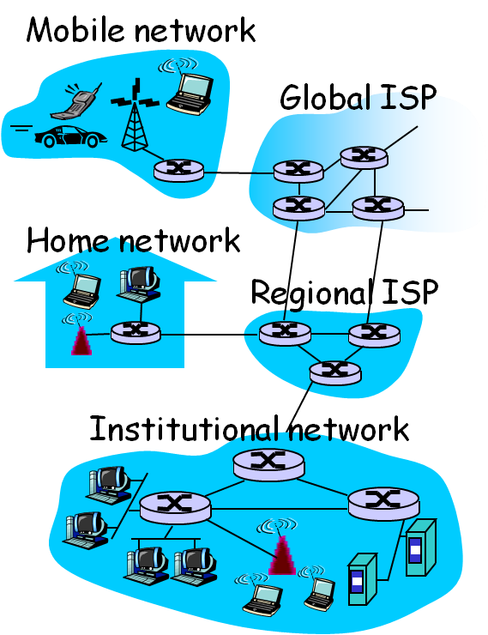
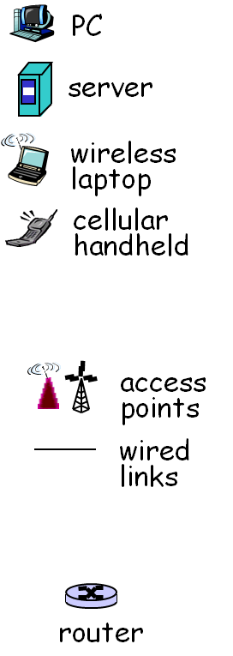
Brief Introduction of Internet
Notes:
网络组成元素：各种主机、路由器
不同类型网络：端网络、骨干网络

Slide 6
What’s the Internet
Millions of connected computing devices
Hosts = End systems
Running network applications
Communication links
Fiber, Copper, Radio, Satellite
Building physical networks
Routers
Forward packets (chunks of data) between physical networks

Slide 7
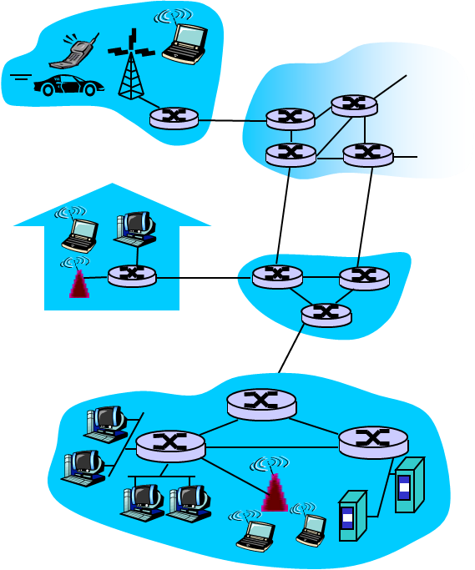
Building Internet – Service View
Communication infrastructure
Enables distributed applications
Web, VoIP, email, online games, e-commerce, file sharing
Communication services provided
Reliable data delivery from source to destination
“best effort” (unreliable) data delivery
Guaranteed delay and throughput

Slide 8
Building Internet
Network Protocols
Control sending, receiving of messages
e.g. HTTP, Skype; TCP, IP; PPP, Ethernet
Internet standards
IETF: Internet Engineering Task Force
RFC: Request for comments
Internet: “network of networks”
Public Internet versus private Intranet
Loosely hierarchical

Slide 9
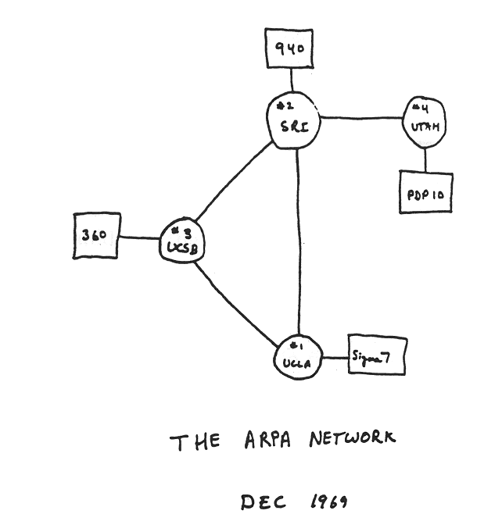
Internet History (1)
1961-1972: Early packet-switching principles
1961: Kleinrock – queuing theory shows effectiveness of packet-switching
1964: Baran – packet-switching in military nets
1967: ARPAnet conceived by Advanced Research Projects Agency
1969: first ARPAnet node operational
1972:
ARPAnet demonstrated publicly
NCP (Network Control Protocol) first host-host protocol
First email program
ARPAnet has 15 nodes

Slide 10
Internet History (2)
1972-1980: Internetworking, new and proprietary nets
1970: ALOHAnet satellite network in Hawaii
1973: Metcalfe’s PhD thesis proposes Ethernet, at Xerox PARC in 1976
1974: Cerf and Kahn – architecture for interconnecting networks
Late70’s:
Proprietary architectures: DECnet, SNA, XNA
Switching fixed length packets (ATM precursor)
1979: ARPAnet has 200 nodes
Cerf and Kahn’s internetworking principles:
Minimalism, autonomy – no internal changes required to interconnect networks
Best effort service model
Stateless routers
Decentralized control
Define today’s Internet architecture

Slide 11
Internet History (3)
1980-1990: new protocols, a proliferation of networks
1983: deployment of TCP/IP
1982: SMTP email protocol defined
1983: DNS defined for name-to-IP-address translation
1985: FTP protocol defined
1988: TCP congestion control
New national networks: Csnet, BITnet, NSFnet, Minitel
100,000 hosts connected to confederation of networks

Slide 12
Internet History (4)
1990’s, 2000’s: commercialization, the Web, new apps
Early 1990’s: ARPAnet decommissioned
1991: NSF lifts restrictions on commercial use of NSFnet (decommissioned in 1995)
Early 1990’s: Web
Hypertext [Bush 1945, Nelson 1960’s]
HTML, HTTP: Berners-Lee
1994: Mosaic, later Netscape
Late 1990’s: commercialization of the Web
Late 1990’s ~ 2000’s:
More killer apps: instant messaging, peer2peer file sharing (e.g. Napster)
Network security to forefront
Est. 50 million host, 100 million⁺ users
Backbone links running at Gbps

Slide 13
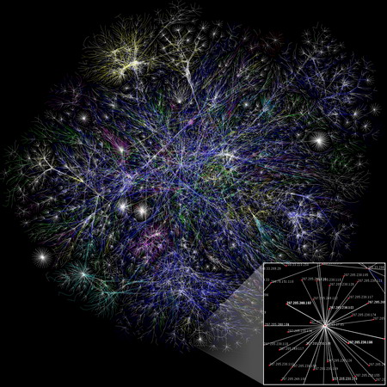
Internet History (5)
2007
~500 million hosts
Voice, Video over IP
P2P applications: BitTorrent (file sharing), Skype (VoIP), PPLive (video)
More applications: YouTube, online gaming
Wireless and mobility

Slide 14
Access Internet
Network edge
Applications and hosts
Network core
Interconnected routers
Network of networks
Access networks
Physical media
Wired and wireless communication links

Slide 15
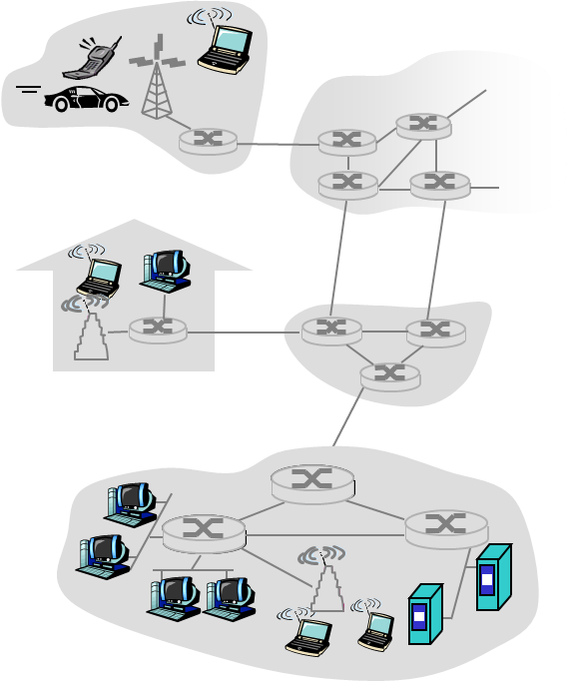
Network Edge
End systems (hosts)
Run application programs
e.g. Web, Email
Client/server model
Client host requests, receives service from always-on server
e.g. Web browser/server; Email client/server
Peer-to-peer model
Minimal (or no) use of dedicated servers
e.g. Skype, BitTorrenth
peer-peer
client/server

Slide 16
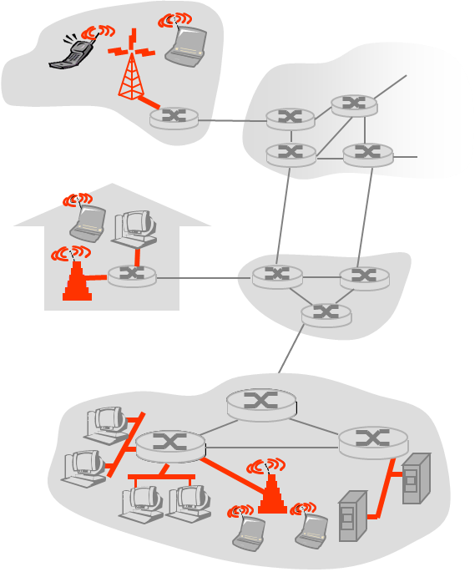
Access Networks
Connect end systems to edge router
Residential (Home) access networks
Institutional access networks (school, company)
Mobile access networks
Performance
Bandwidth (bits per second) of access network
Shared or dedicated

Slide 17
Residential Access
Dialup via modem
Up to 56Kbps direct access to router
DSL: digital subscriber line
Deployment: telephone company
Up to 1 Mbps upstream, and 8 Mbps downstream
Dedicated physical line to telephone central office
HFC: hybrid fiber coax
Asymmetric: up to 30Mbps downstream, 2 Mbps upstream
Homes share access to ISP router
Deployment: cable TV companies

Slide 18
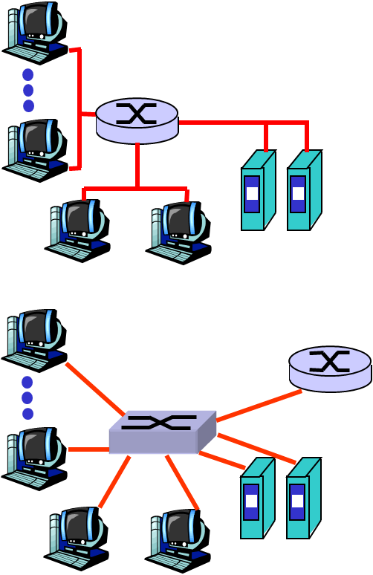
Company access: Local Area Networks
Company/University local area network (LAN) connects end systems to edge router
Ethernet:
10 Mbs, 100Mbps, 1Gbps, 10Gbps Ethernet
Modern configuration: end systems connect into backbone of Ethernet switches

Slide 19
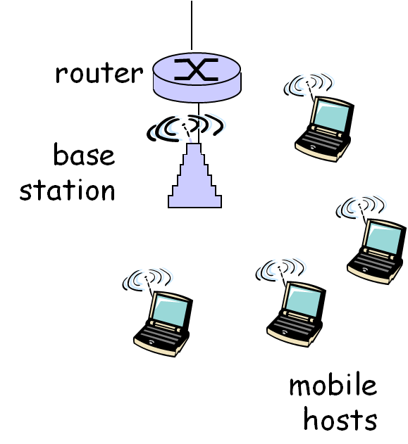
Wireless Access Networks
Shared wireless media connects end system to router
via base station, or “access point”
Wireless LANs:
802.11b/g (WiFi): 11 or 54 Mbps
Wider-area wireless access
Provided by telecommunication operator
~1Mbps over cellular system
Next up (?): WiMAX (10’s Mbps) over wide area

Slide 20
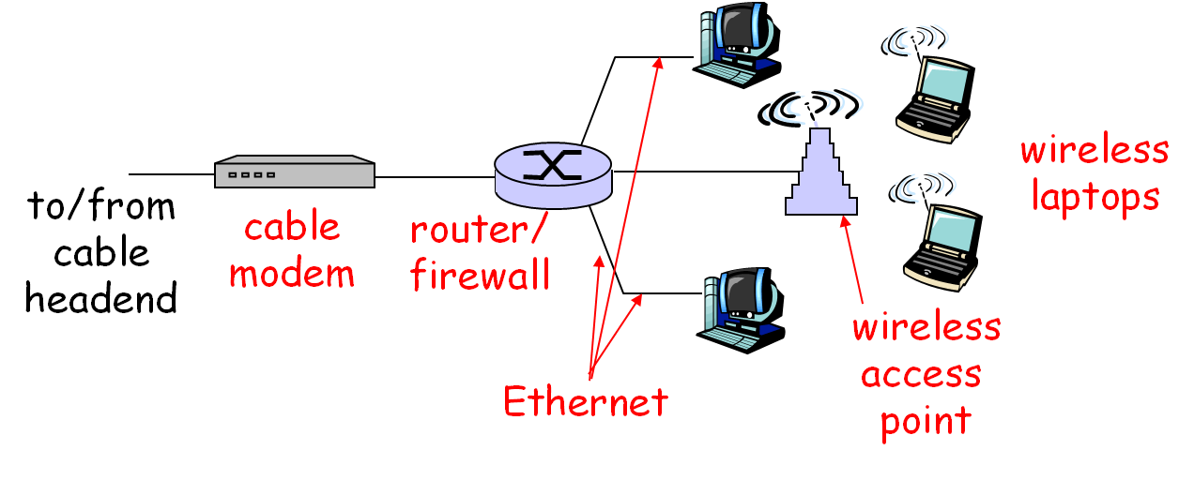
A Modern Family
A home network components:
DSL or cable modem
Router/Firewall/NAT
Ethernet switch
Wireless access point

Slide 21
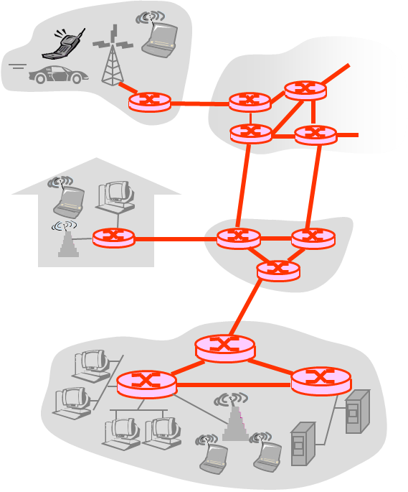
The Network Core
Mesh of interconnected routers
Fundamental question
How is data transferred through the net?
Circuit switching
Dedicated circuit per call, e.g. telephone net
Packet-switching
Data sent through net in discrete chunks

Slide 22
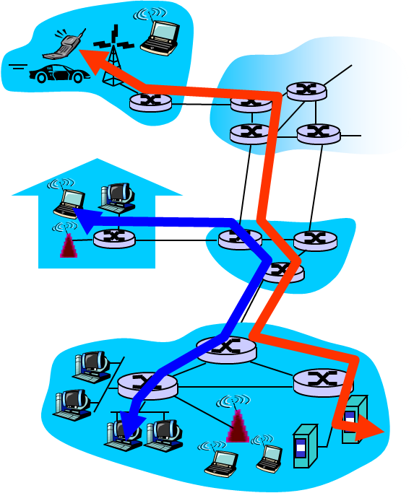
Circuit Switching
End-to-end resources reserved for “call”
Link bandwidth, switch capacity
Dedicated resources: no sharing
Circuit-like (guaranteed) performance
Call setup/teardown required

Slide 23
Packet Switching
Each end-to-end data stream divided into packets
Application A, B packets share network resources
Store and forward: packets move one hop at a time, stored (queued) at switches
Each packet uses full link bandwidth
Resource contention: aggregate (burst-up) resource demand can exceed amount available
Congestion: packets queue and wait for link use

Slide 24
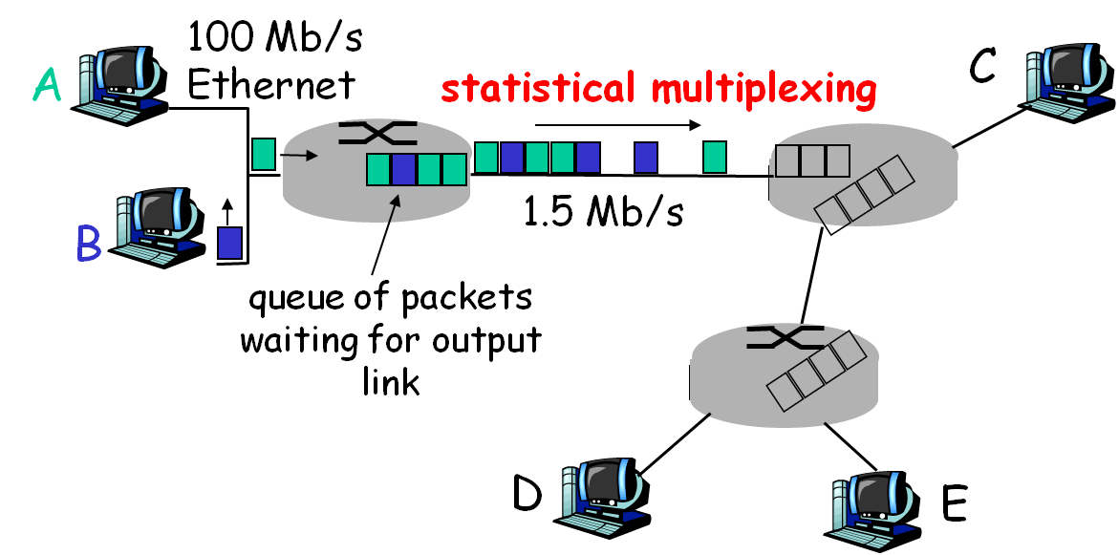
Statistical Multiplexing
Link bandwidth shared on demand
Sequence of packets does not have fixed pattern

Slide 25
Virtual Circuit
Circuit Switching + Packet Switching
Routes or main cross roads are fixed
Resources shared, congestion control needed
Resources can be preserved, leading to different performance
Connection setup/teardown needed

Slide 26
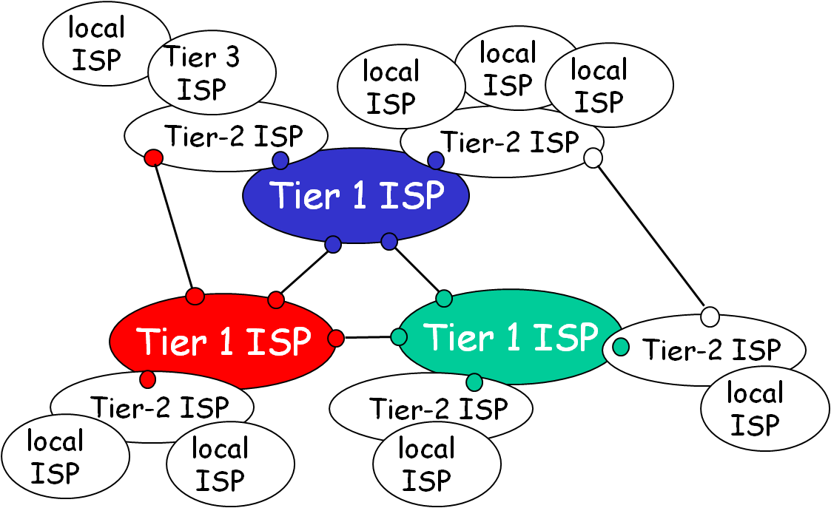
Internet Structure – Network of Networks
Roughly hierarchical
At center: “tier-1” (National) ISPs
“Tier-2” ISPs: smaller (often regional) ISPs
“Tier-3” ISPs and local/edge ISPs, connect access networks
Notes:
Internet Service Provider
国家骨干网—教育网—校园网

Slide 27
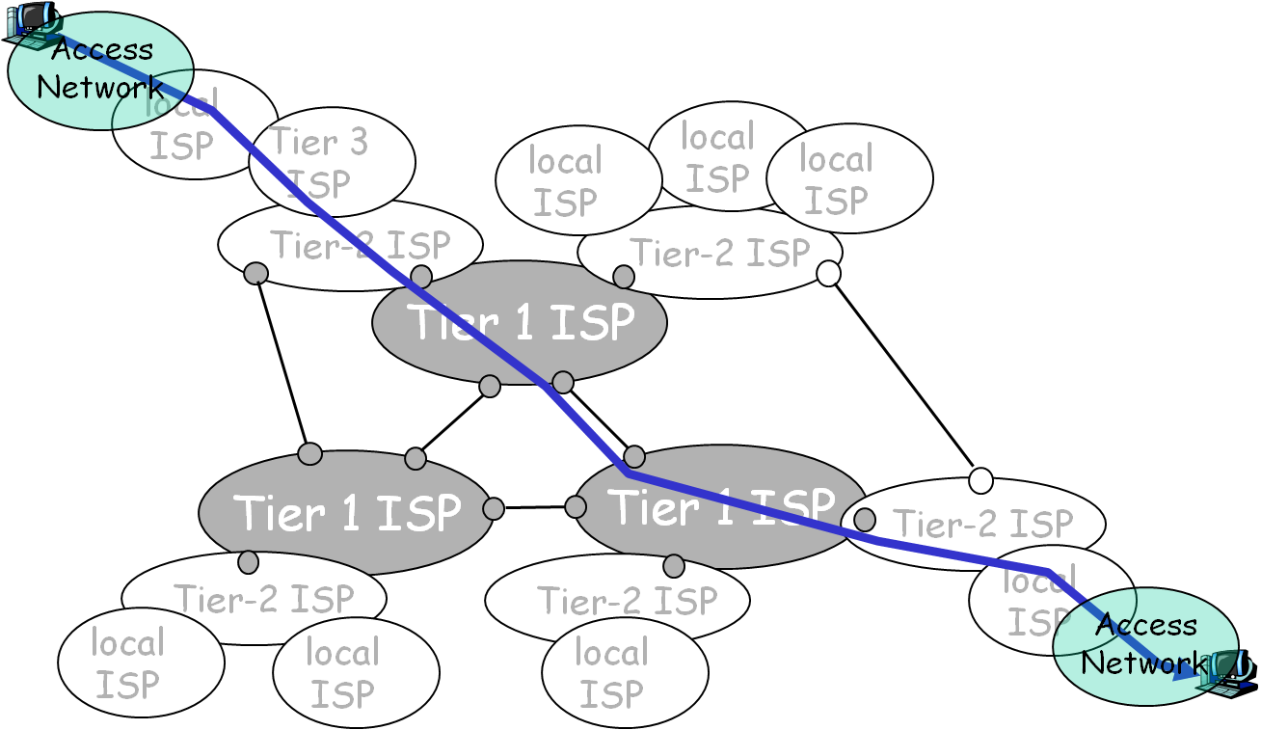
Internet – Network of Networks
A packet may pass through many networks

Slide 28
Typical Network Applications
Client/Server Applications
Web and HTTP
FTP
Electronic Mail
P2P Applications
BitTorrent
Skype

Slide 29
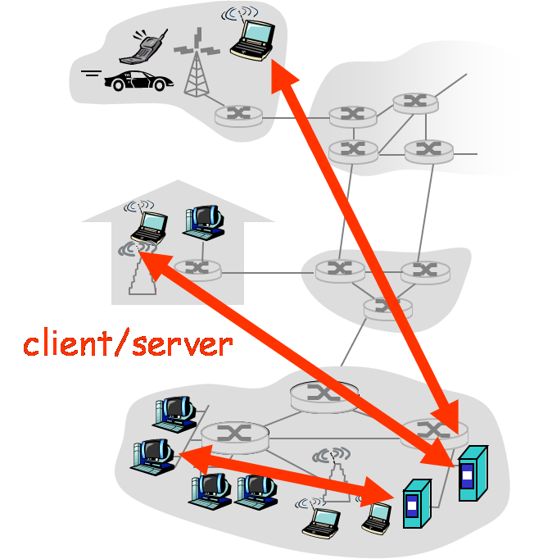
Client-Server Architecture
Server
Always-on host
Permanent IP address
Server farms for scaling
Clients
Communicate with server
May be intermittently connected
May have dynamic IP addresses
Do not communicate directly with each other

Slide 30
Web and HTTP
Clients use browser to send URL(URI)s via HTTP to servers requesting a Web page
Web pages constructed using HTML (or other markup language), inter-connected by URL
Servers (or caches) respond with requested Web page
Client’s browser displays Web page returned by server
HTTP request
PC running
Explorer
HTTP response
HTTP request
Server
running
Apache Web
server
HTTP response
Mac running
Navigator

Slide 31
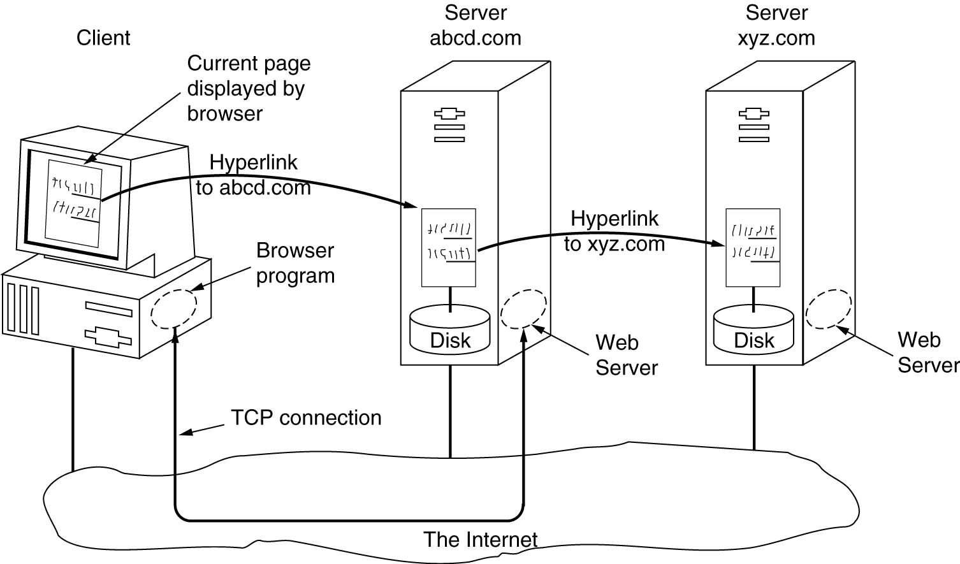
WWW Architecture

Slide 32
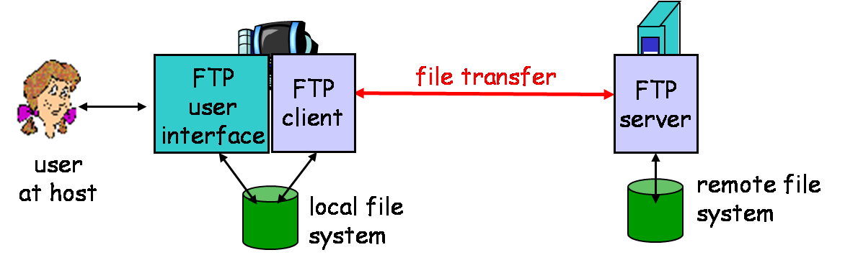
FTP
Transfer file to/from remote host
Control connection
Login/logout, file transfer command/reply
Data connection
Transferring file contents
Client side initiates file transfer

Slide 33
Electronic Mail
SMTP: Simple Mail Transfer Protocol
Delivery of simple text mail
MIME: Multi-purpose Internet Mail Extension
Express of other types of data, e.g. voice, images, video clips
POP: Post Office Protocol
Mail retrieval from server, including authorization and download
IMAP: Internet Mail Access Protocol
Manipulation of stored mails on server

Slide 34
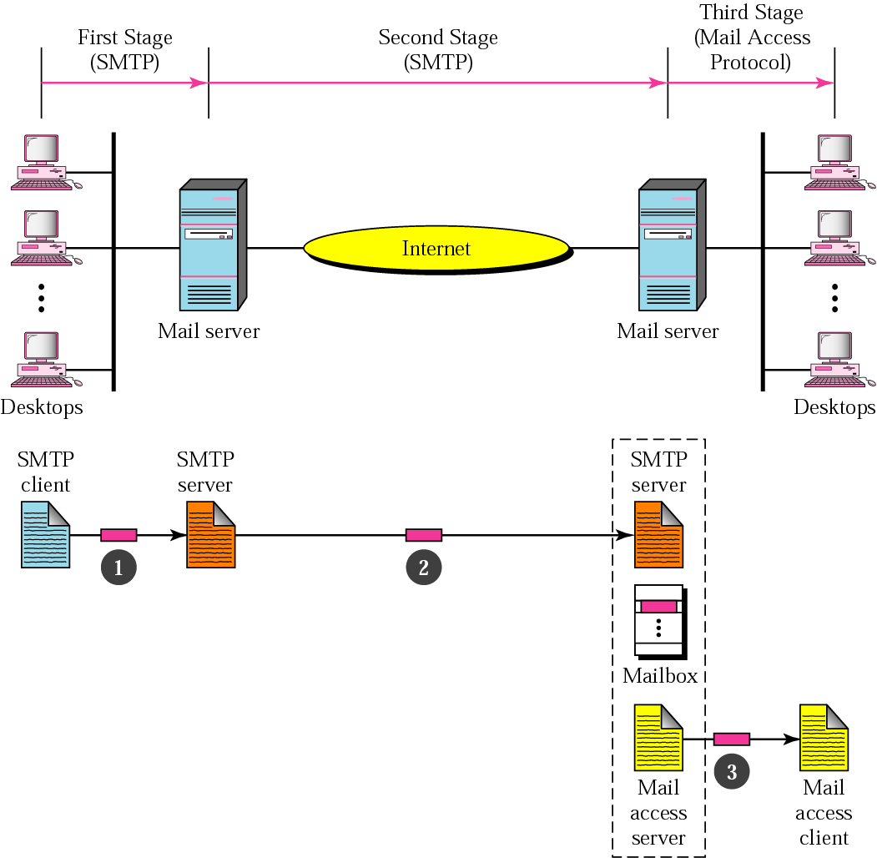
Illustration of A Mail System
Pop3, IMAP4, or HTTP
RFC 822, MIME

Slide 35
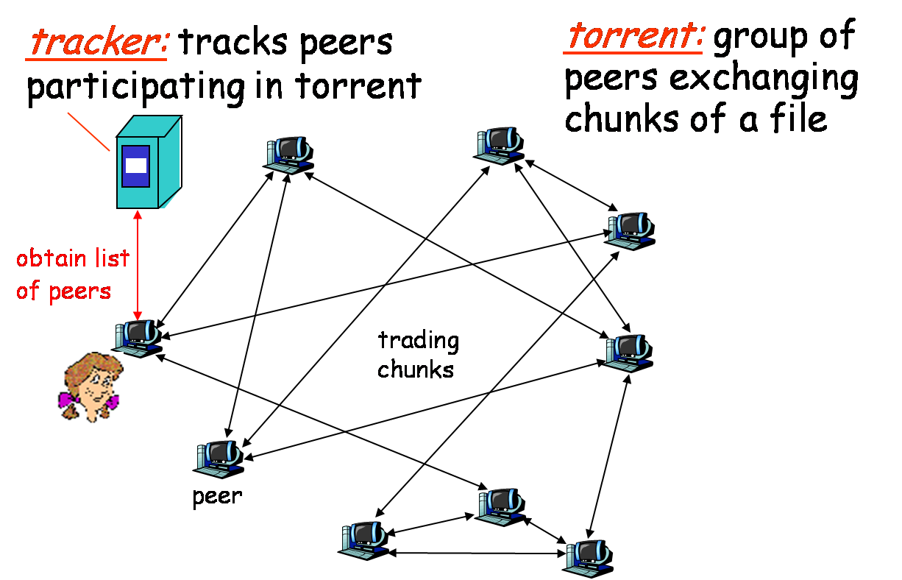
P2P Application: BitTorrent
P2P file sharing & distribution

Slide 36
BitTorrent
File divided into 256kB chunks
Peer (Alice) joining torrent:
Register with tracker to get list of peers, connects to subset of peers (“neighbors”)
Alice issues requests for her missing chunks
While downloading, Alice uploads chunks to other peers
Send chunks to 4 neighbors currently sending her chunks at the highest rate
Peers may come and go

Slide 37
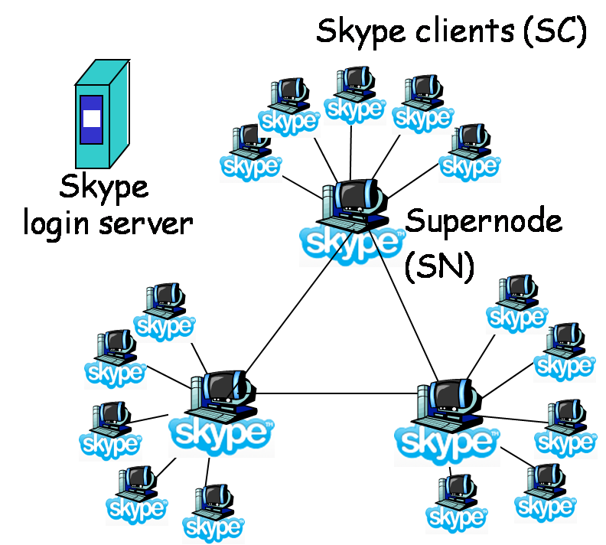
P2P Application: Skype
P2P Voice-Over-IP (VoIP) application
pc-to-pc, pc-to-phone, phone-to-pc
Proprietary application-layer protocol

Slide 38

Skype: Making a Call
User starts Skype
SC registers with SN
SC logs in (authenticate)
Call: SC contacts SN with callee ID
SN contacts other SNs to find address of callee
SC directly contacts callee, over TCP
Skype
login server
Notes:
Super Node

Slide 39
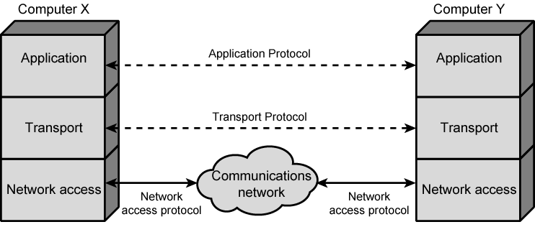
Protocol Layers and Service Model
A layered structure for File Transfer application
Protocol – handle the communication issues between peer entities

Slide 40
Functions of 3 Layers
Network Access Layer
Carrying data from source to destination, and vice versa
Addresses of source and destination
Routing data through the network
Transport Layer
(Reliable) Data exchange between end hosts
Error recovery, Flow control
Application Layer
Handle the file transfer between different hosts
Login / Logout; Session control; Format translation (code / decode)

Slide 41
Many Things to Handle
Encapsulation
Segmentation and reassembly
Connection control
Ordered delivery
Flow control
Error control
Addressing
Multiplexing
Transmission services (QOS)

Slide 42
Addressing Requirements
At least 2 levels of addressing required
Each computer needs unique network address
Each application on a (multi-tasking) host needs a specific address within the host
i.e. the service access point (SAP)
e.g. the FTP port 21 on TCP/IP stacks on computer 202.106.182.120

Slide 43
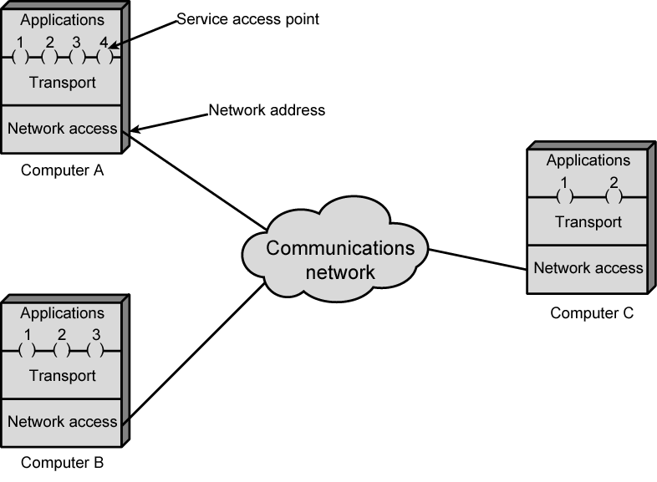
Addressing Requirements

Slide 44
Standard Protocol Architectures
Two standards:
OSI Reference model
Never lived up to early promises
TCP/IP protocol suite
Most widely used
Others
IBM Systems Network Architecture (SNA)
DECNet, Netware

Slide 45
OSI
Open Systems Interconnection
Developed by the International Organization for Standardization (ISO)
Seven layers structure
A theoretical system delivered too late
TCP/IP is the de facto standard now

Slide 46
OSI – The Model
A layer model, and flow structure
Each layer performs a subset of the required communication functions
Each layer relies on the next lower layer to perform more primitive functions
Each layer provides services to the next higher layer
Changes in one layer should not require changes in other layers

Slide 47
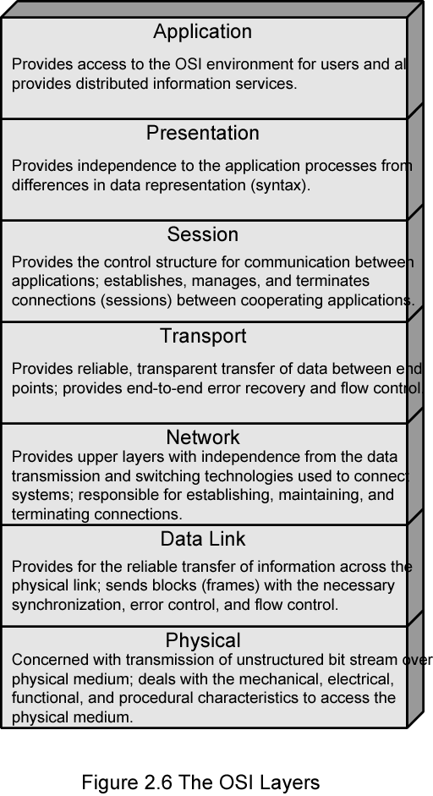



OSI Layers
请客吃饭
中文表述
听说同步
摘机拨号
PBX中转
信号传输
插口、双绞线
Notes:
打电话：请客吃饭；中文语言；你说我听；摘机拨号；PBX中转；信号传输；双绞线

Slide 48




Physical Layer
Transfers bits across link
Specification of the physical aspects of a comm link
Mechanical: cable, plugs, pins...
Electrical/optical: modulation, signal strength, voltage levels, bit times, …
Functional/procedural: activate, maintain, deactivate physical links…
Physical interface between devices
Ethernet, DSL, cable modem, telephone modems, …
Twisted-pair cable, coaxial cable, optical fiber, radio, infrared, …
Notes:
Digital Subscriber Line
屏蔽物理媒体的差异

Slide 49
Data Link Layer
Groups bits into frames
Activation, maintenance, & deactivation of data link connections
Transfers frames across direct connections
Medium access control for local area networks
Detection of bit errors; Retransmission of frames
End-to-end flow control
Higher layers may assume error free transmission
Notes:
端到端无差错传输

Slide 50
Network Layer
Transfers packets across multiple links / multiple networks
Addressing must scale to large networks
Nodes jointly execute routing algorithm to determine paths across the network
Forwarding transfers packet across a node
Congestion control to deal with traffic surges
Connection setup, maintenance, and teardown when connection-based
Notes:
路由和流量控制
面向连接：如ATM

Slide 51
Transport Layer
Exchange of data between end systems
Transfers data end-to-end from process in one host to process in another host
Reliable stream transfer or quick-and-simple single-block transfer
Error free
In sequence
No losses
No duplicates
Connection setup, maintenance, and release
Notes:
端到端无差错传输

Slide 52
Upper Layers
Session
Control of dialogues between applications
Dialogue discipline
Grouping data
Checkpoint recovery
Presentation
Machine-independent representation of data
Data formats and coding
Data compression & encryption
Application
Means for applications to access OSI environment
Incorporated into Application Layer Now
Notes:
描述语法
传送语法

Slide 53
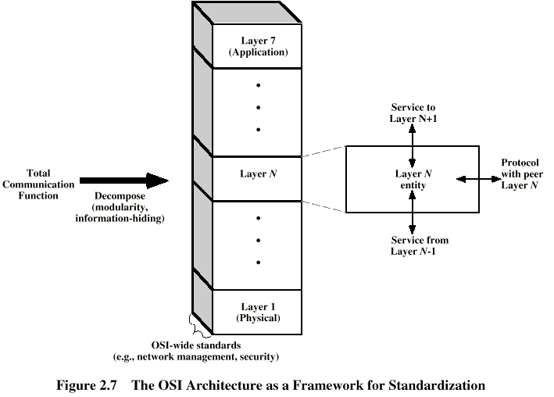
OSI as Framework for Standardization
Interface
Protocol

Slide 54
Service Primitives and Parameters
REQUEST | Issued by a user (upper layer) to invoke some service Parameters fully specify the requested service
INDICATION | Issued by a service provider (lower layer) either to: Indicate that a procedure has been invoked by peer service user, or Notify the service user of a provider-initiated action
RESPONSE | Issued by peer user to acknowledge or complete previously invoked procedure
CONFIRM | Issued by service provider to acknowledge or complete previously invoked procedure

Slide 55
Service Primitives
connect.request → connect.indication →
connect.response → connect.confirm
(N) Service User A
(N) Service User B
Confirm
Request
Indication
Response
(N-1) the Service Provider

Slide 56
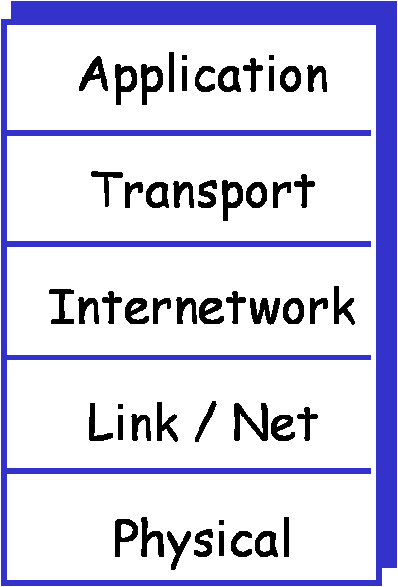
TCP/IP Protocol Architecture
Used by the global Internet
Application: supporting network applications
FTP, SMTP, HTTP
Transport: process-process data transfer
TCP, UDP
Internetwork: routing of datagrams across net of nets
IP, routing protocols
Link: data transfer between neighboring routers / hosts
PPP, Ethernet
Physical: bits “on the wire”

Slide 57
Protocol Data Units
At each layer, Control info is added to user data to ease communication, e.g.
Transport layer segments application data
Each segment has a transport header added
Destination SAP
Sequence number
Error detection code
This gives a transport protocol data unit (PDU)

Slide 58
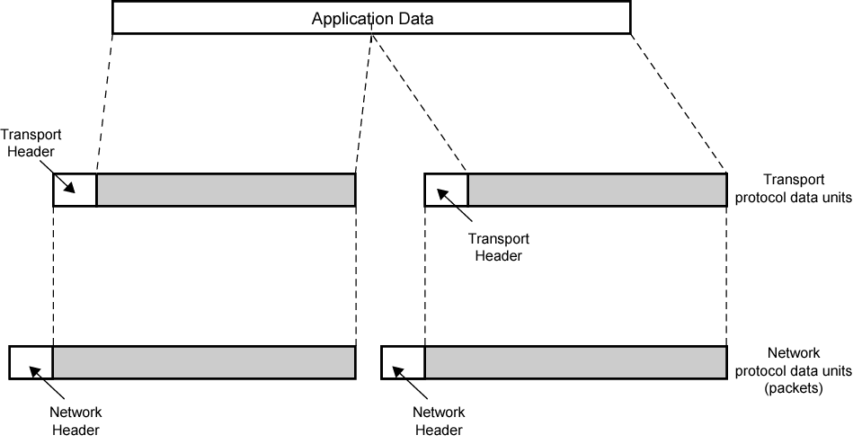
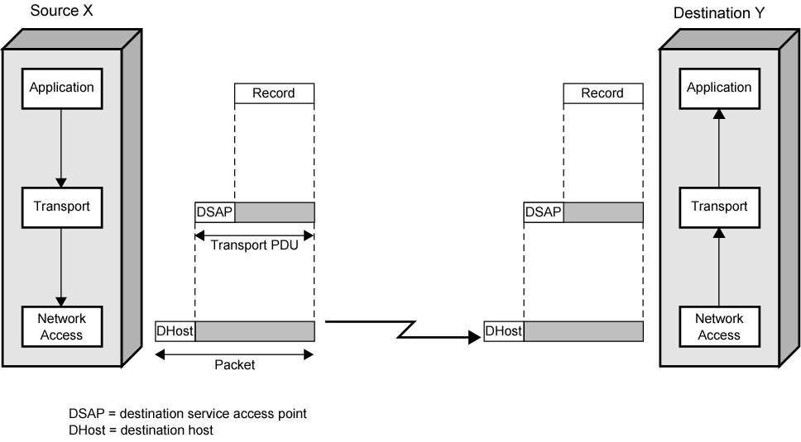
PDUs in Transfer

Slide 59
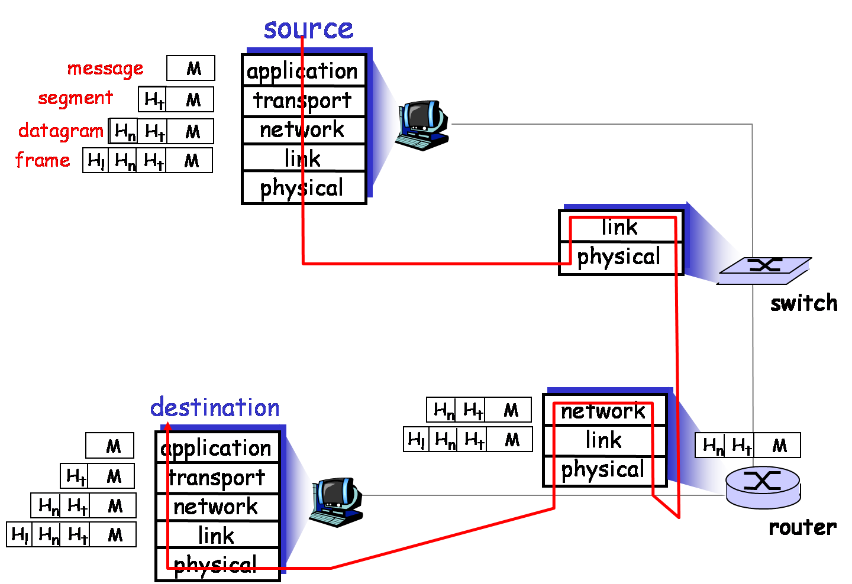
Encapsulation

Slide 60
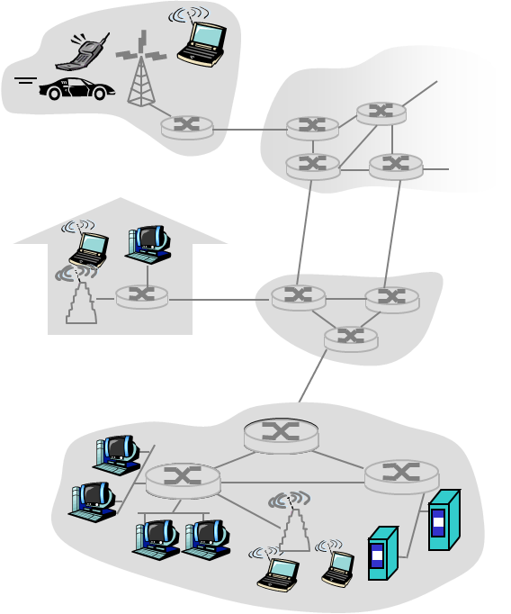
The IP Layer in Detail
Sender encapsulates segments into datagrams
Receiver delivers segments to transport layer
IP layer entity resides on each host and router
Router examines header fields in all IP datagrams passing through it
application
transport
network
data link
physical
network
data link
physical
network
data link
physical
network
data link
physical
network
data link
physical
network
data link
physical
network
data link
physical
network
data link
physical
network
data link
physical
network
data link
physical
application
transport
network
data link
physical
network
data link
physical
network
data link
physical

Slide 61
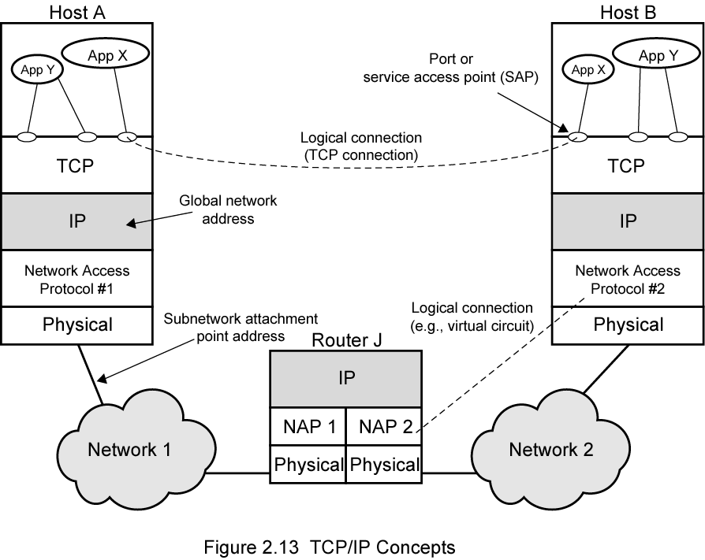
Look At This
Notes:
主机和路由器
各个层次的协议通信

Slide 62
Network Programming
Socket programming
Build client/server application that communicate using sockets
A socket is a pair of <IP addresses, port>
Socket API
Introduced in BSD4.1 UNIX, 1981
Explicitly created, used, and released by applications
Implementing client/server paradigm
2 types of transport service via socket API
Unreliable datagram, i.e. UDP
Reliable, byte stream-oriented, i.e. TCP

Slide 63
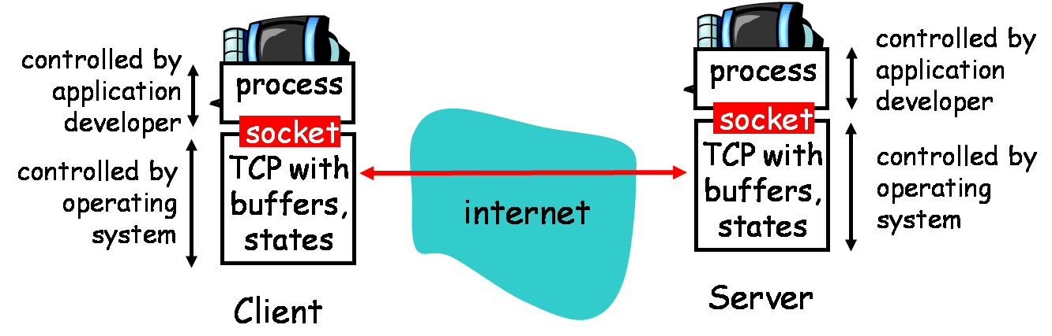
Socket Programming via TCP
TCP Services
Reliable transfer of bytes (octets) from one process to another

Slide 64
Socket Programming with TCP
Client must contact server
Create a client-local TCP socket
Specify <IP_{s}, Port_{s}> of server process
Receive server reply, a connection is created on <IP_{c}, Port_{c}; IP_{s}, Port’_{s}>
Server is running first
Server have created a socket that is listening
Accept the client contact, create a new socket to communicate with client
Connection created on <IP_{c}, Port_{c}; IP_{s}, Port’_{s}>
Using <IP_{c}, Port_{c}> to distinguish different clients

Slide 65
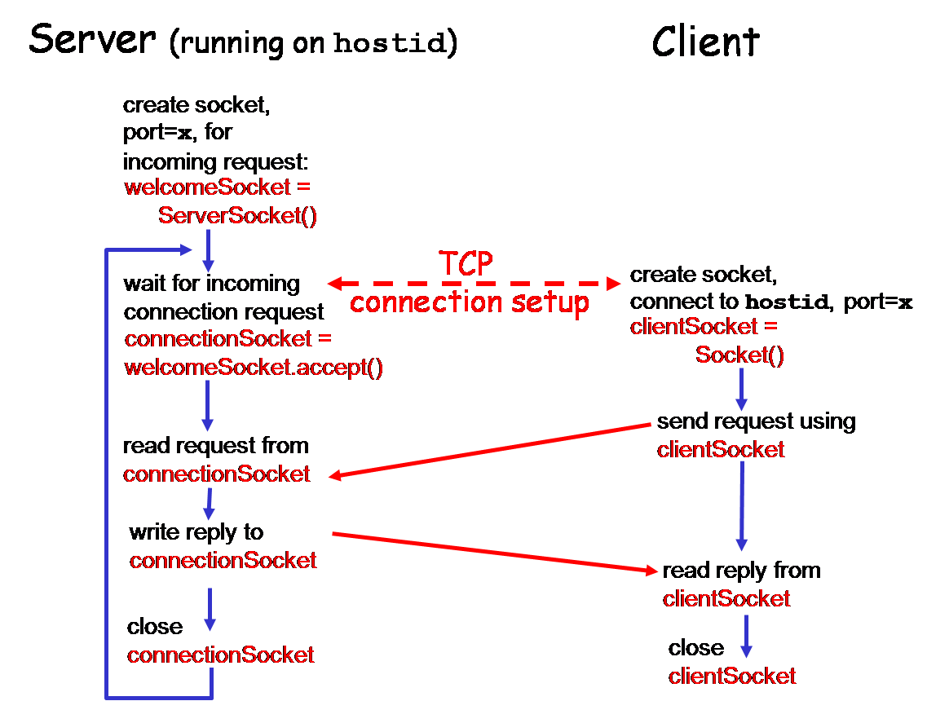
Client/Server Socket Interaction

Slide 66
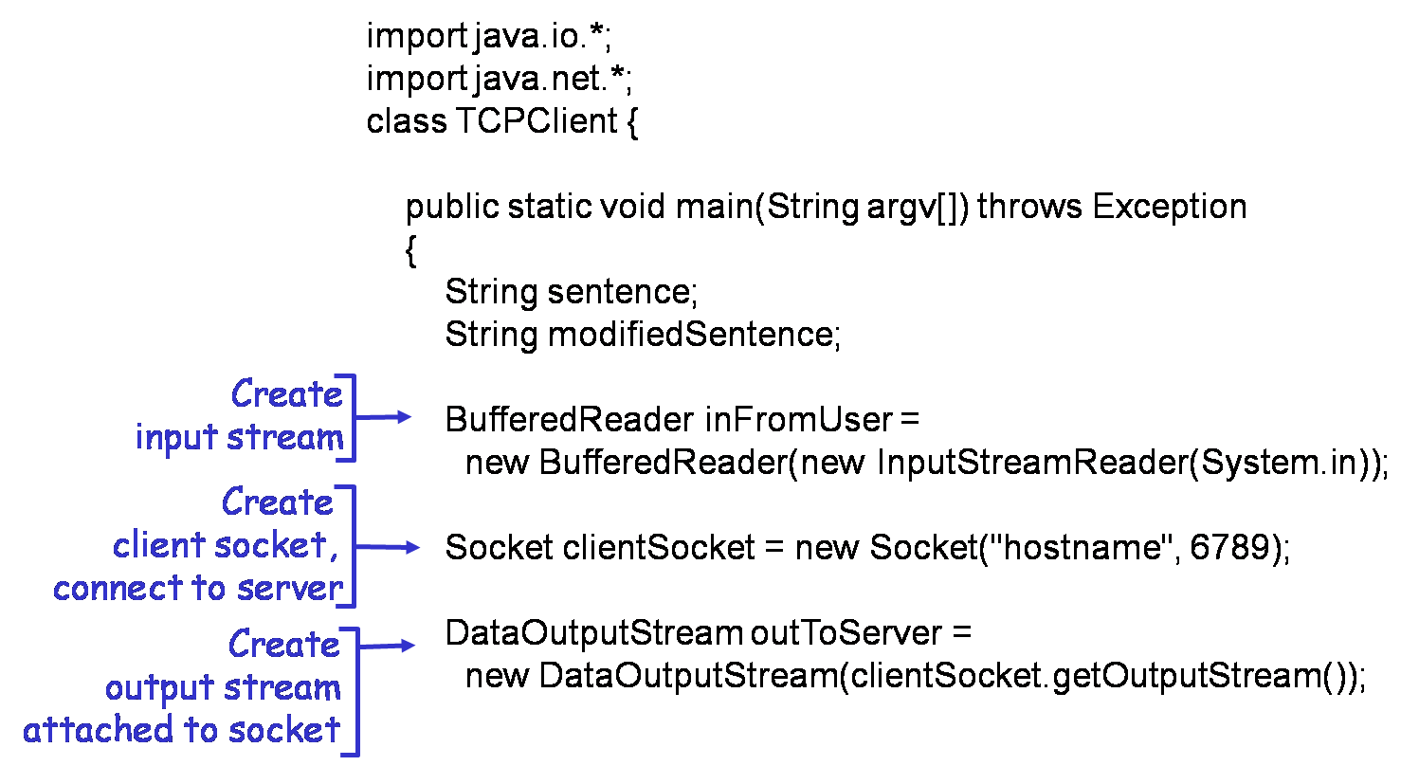
Example: Java Client (TCP)

Slide 67
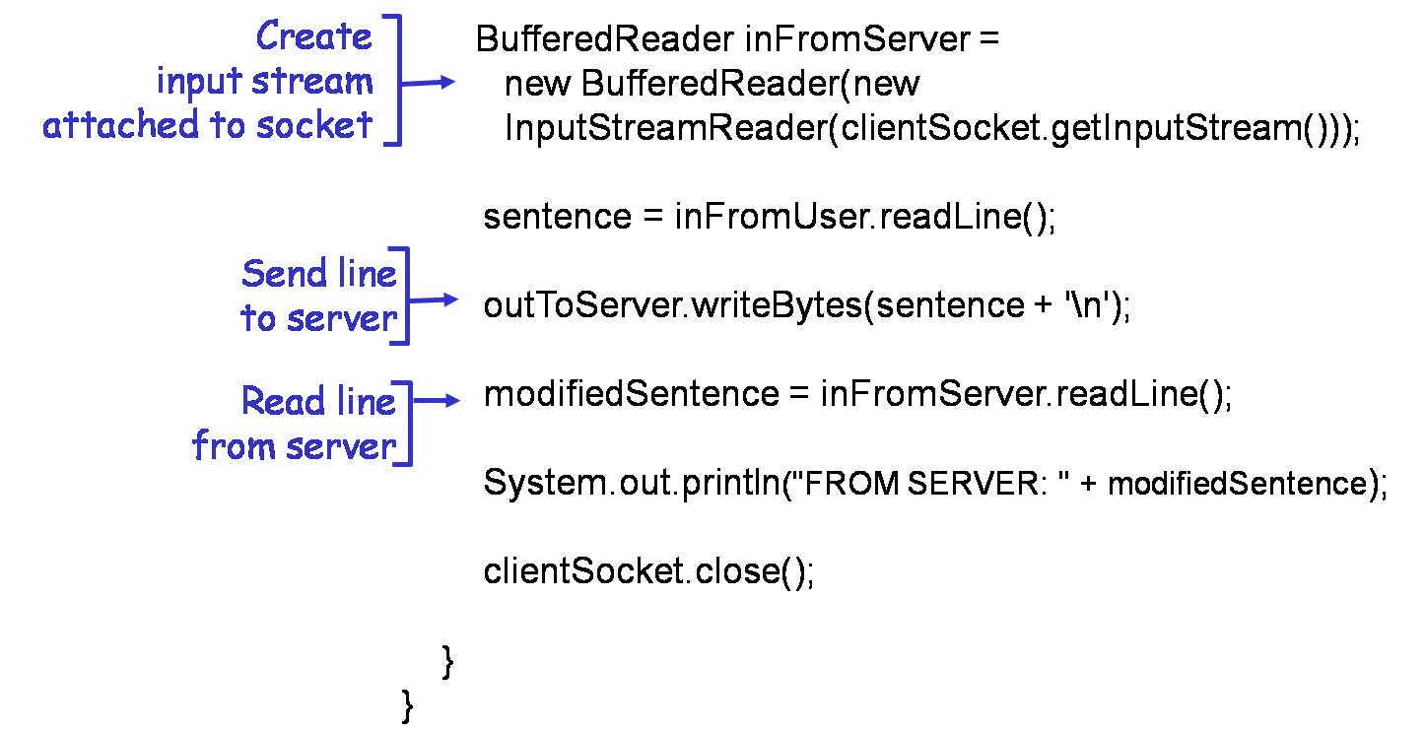
Example: Java Client (TCP)

Slide 68
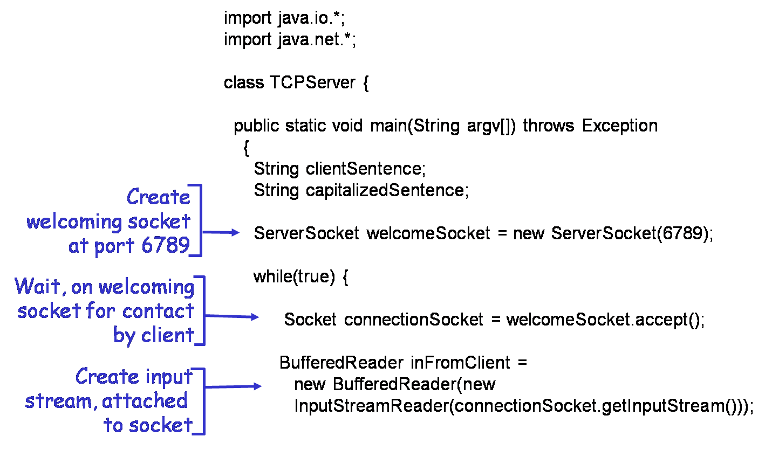
Example: Java Server (TCP)

Slide 69
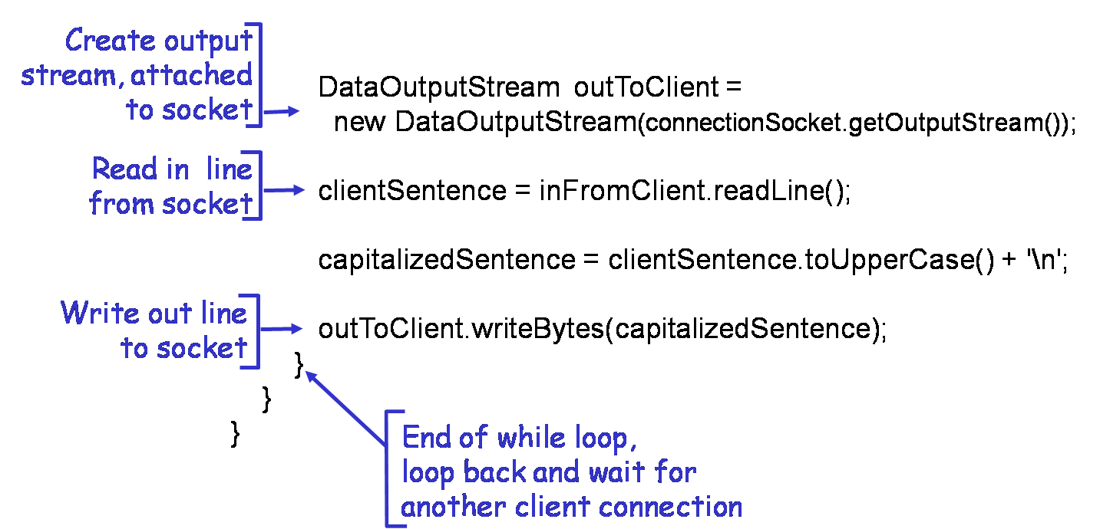
Example: Java Server (TCP)

Slide 70
Socket Programming with UDP
UDP: no “connection” between client and server
A socket pair <IP_{c}, Port_{c}; IP_{s}, Port_{s}> is also used, by each datagram
Sender explicitly attaches IP address and port of destination to each packet
Receiver must extract IP address, port of sender from received packet
Transmitted data may be received out of order, or lost

Slide 71
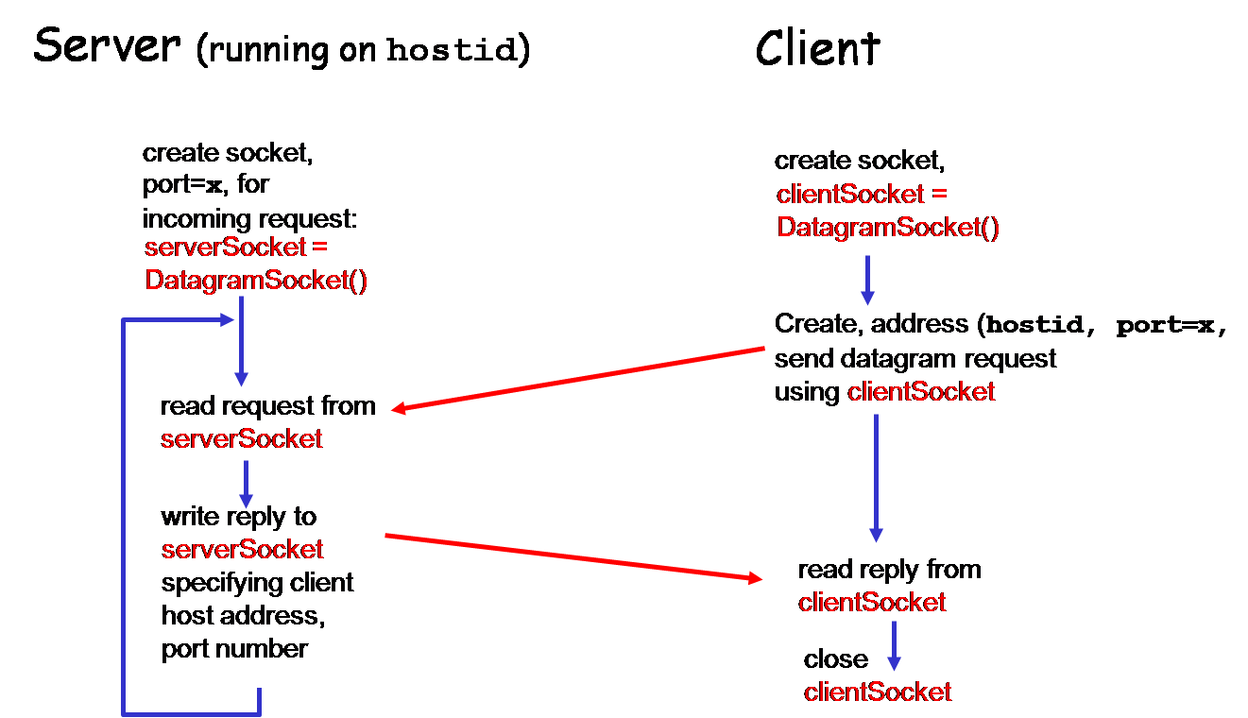
Client/Server Socket Interaction

Slide 72
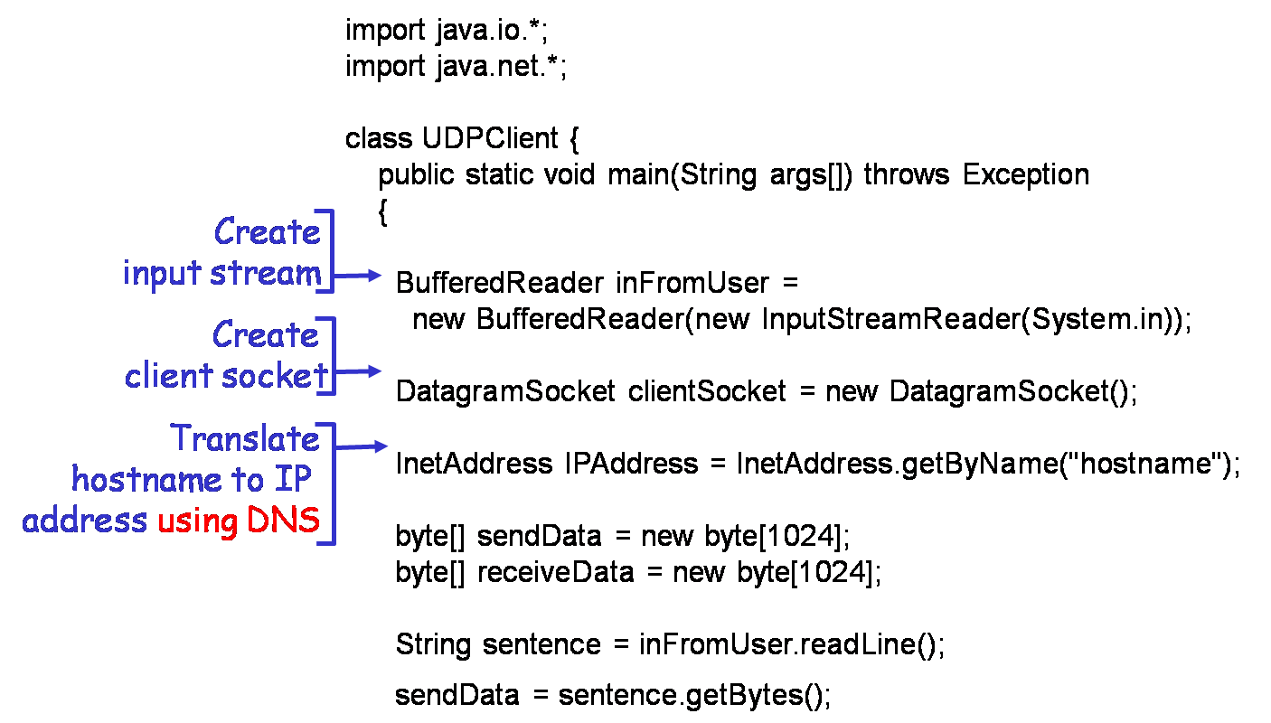
Example: Java Client (UDP)

Slide 73
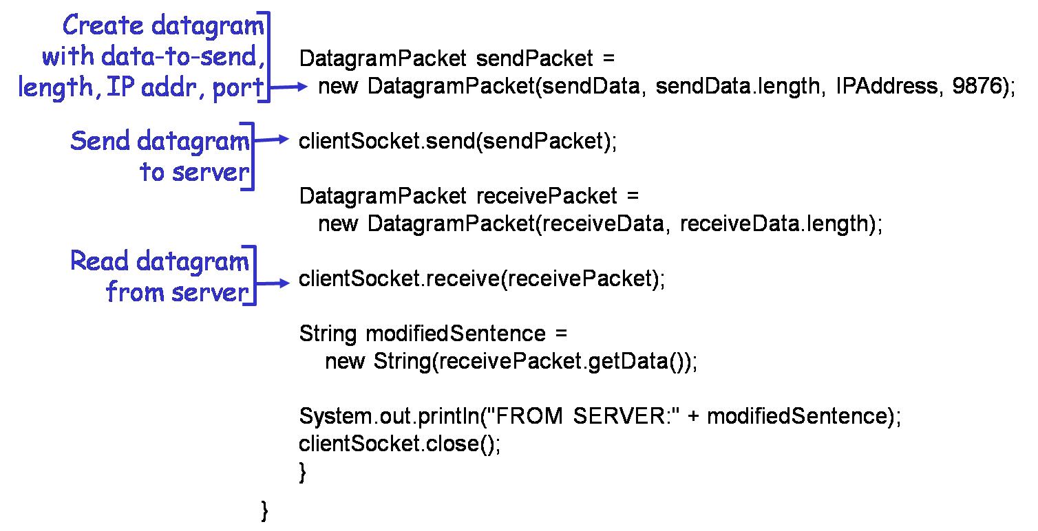
Example: Java Client (UDP)

Slide 74
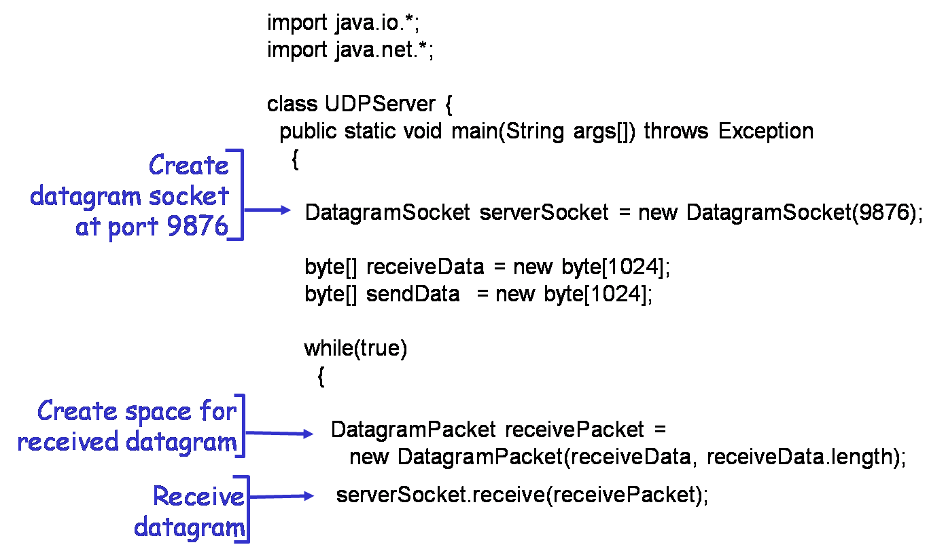
Example: Java Server (UDP)

Slide 75
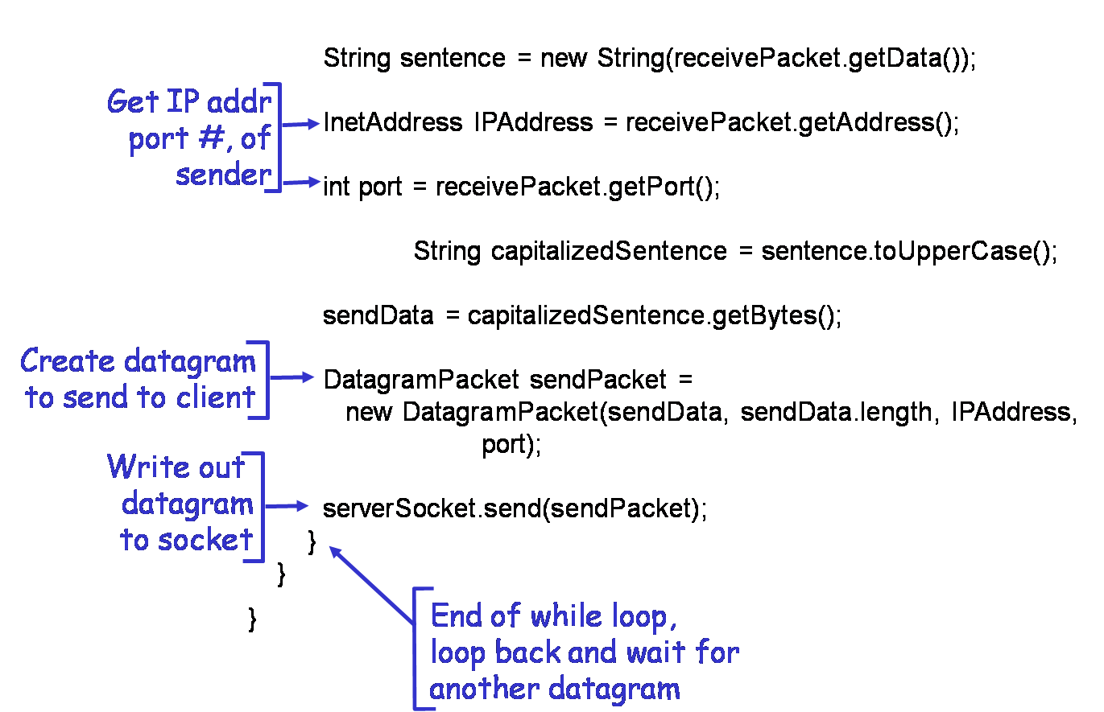
Example: Java Server (UDP)

Slide 76
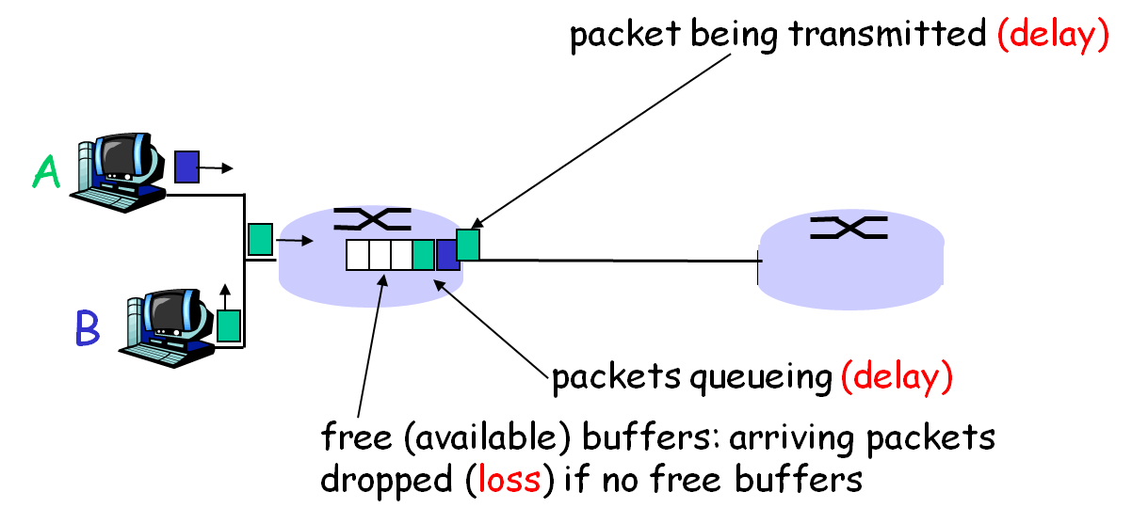
Delay, Loss and Throughput
Packets queue in switch buffers
Packet arrival rate exceeds output link capacity
Packet queues, wait for its turn

Slide 77
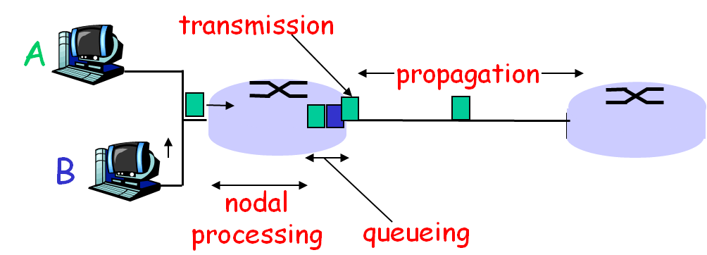
Four Sources of Packet Delay
1. Transmission
R=link bandwidth (bps)
L=packet length (bits)
Time to send bits into link = L/R
2. Propagation
d = length of physical link
s = propagation speed in medium (~2x10⁸ m/sec)
Propagation delay = d/s

Slide 78
Four Sources of Packet Delay
3. Nodal processing
Check bit errors
Determine output link
4. Queuing
Time waiting at output link for transmission
Depending on congestion level of router

Slide 79
Magnitude of Different Delay
Transmission delay
Significant for low-speed links, now typically a few microseconds or less
Propagation delay
A few micro-seconds to hundreds of milliseconds
Nodal processing delay
Typically a few microseconds or less
Queuing delay
Depends on congestion, maybe seconds

Slide 80
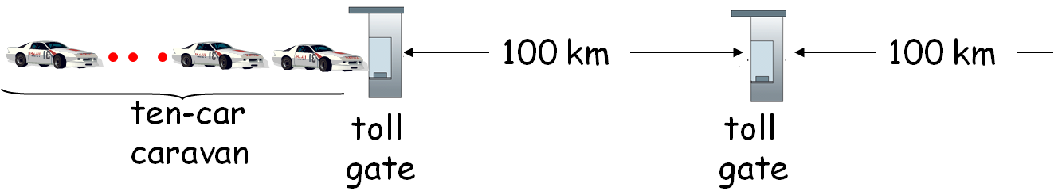
Caravan Analogy
Cars “propagate” at 100 km/hr
Toll gate takes 12 sec to service car (nodal+trans)
Car: packet; Caravan: packet flow
Q: How long until caravan is lined up before 2nd toll gate?
Time to “push” entire caravan through toll gate = 12×10 = 120 sec
Time for last car to propagate from 1st to 2nd toll gate: 100km/(100km/hr)= 1 hr
Answer: 62 minutes
Q: what about a single car?

Slide 81
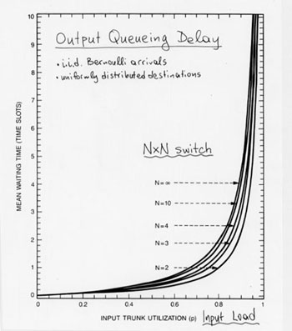
Queuing Delay
R=link bandwidth (bps)
L=packet length (bits)
α=average packet arrival rate
Traffic intensity ρ = L×α/R
Intensity ρ ~ 0 : average queuing delay small
Intensity ρ →1 : delays become large, and huge
Intensity ρ ≥ 1 : average delay infinite

Slide 82
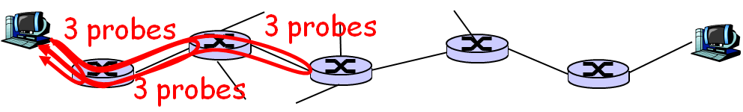
“Real” Internet Delays and Routes
traceroute
Provides delay measurement from source to router along end-to-end Internet path towards destination
Each intermediate router will return packets to sender
Sender records time interval between transmission and reply

Slide 83
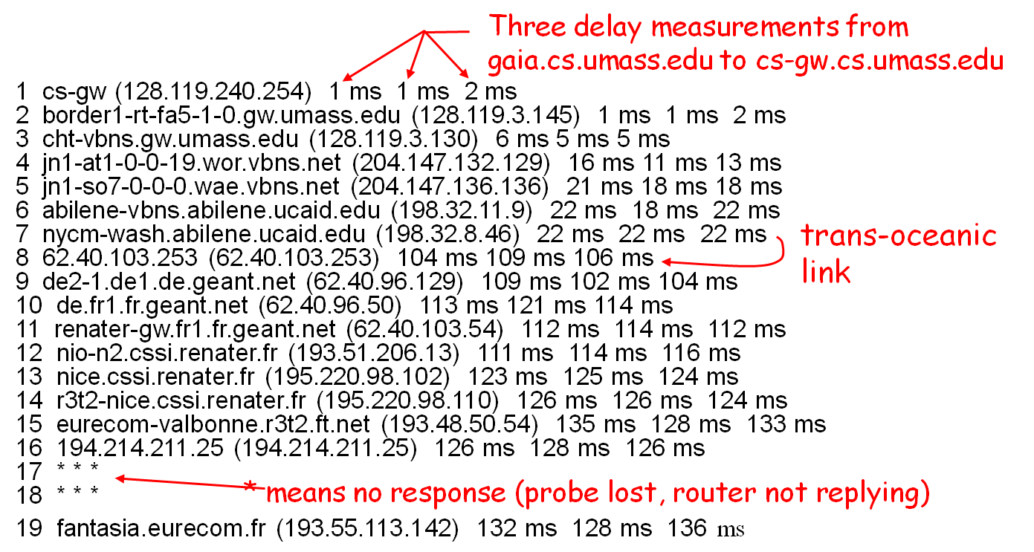
“Real” Internet Delays and Routes
traceroute: gaia.cs.umass.edu to www.eurecom.fr

Slide 84
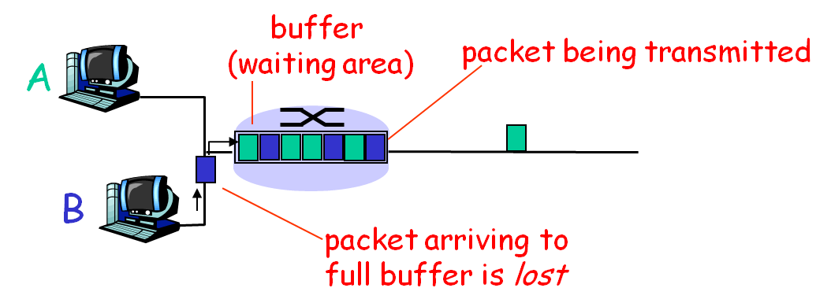
Packet Loss
Link in buffer of a router has finite capacity
Packet arriving to full queue dropped (i.e. lost)
Lost packet may be retransmitted by previous node, by source end system, or not at all

Slide 85
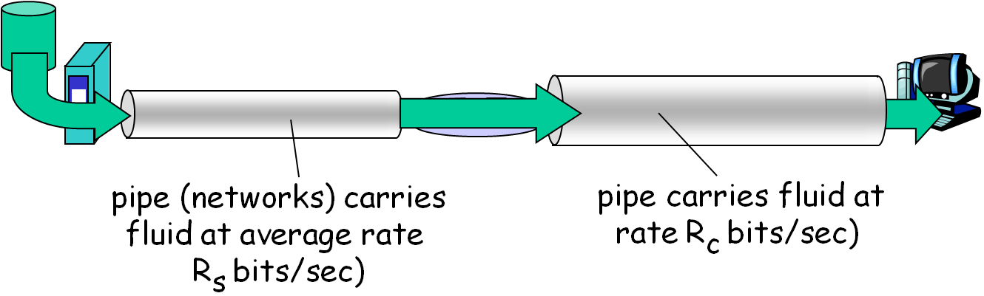
Throughput
Throughput
Rate (bits/unit per time) at which bits transferred between sender/receiver
Instantaneous: rate at given point in time
Average: rate over a period of time

Slide 86

Throughput – Multiplexing
Per-connection end-to-end throughput:
min(R_{c}, R_{s}, R/10)
In practice: R_{s} (or R) is often the bottleneck

Slide 87
Networks under Attack: Security
Attacks on Internet infrastructure
Infecting/attacking hosts: malware, spyware, worms, unauthorized access
Packet sniffing, replay, masquerade
Denial of service: deny access to resources (servers, link bandwidth)
Internet not originally designed with security in mind
Original vision: “a group of mutually trusting users attached to a transparent network”
Internet protocol designers playing “catch-up”
Security considerations in all layers!

Slide 88
Different Types of Malware
Virus
Infection by receiving and running (unwarily) executables
Self-replicating: propagate itself to other executables
Worm
Actively transmitting itself over a network to infect other hosts
Trojan horses
Disguised as something innocuous or desirable, tempting the user to run it

Slide 89

Different Types of Malware
Backdoor
Providing a method of bypassing normal authentication procedures
Adware
Playing, displaying, or downloading advertisements to the user host
Spyware
Infecting in the same way as Trojan horses
Recording keystrokes, web sites visited, uploading info to collection site

Slide 90

Denial of Service (DOS)
Attackers make resources (server, bandwidth) unavailable by overwhelming resource with bogus traffic
e.g. multiple coordinated sources swamp server with TCP SYN message
1. Select target
2. Break into hosts around the network using malware
3. Send packets toward target from compromised hosts
Notes:
拒绝服务

Slide 91
Packet Sniffing
Broadcast media (e.g. Ethernet or WiFi)
Promiscuous NIC reads/records all packets passing by
Can read all unencrypted data (e.g. passwords)
e.g. C sniffs B’s packets
A
C
src:B dest:A payload
B
Notes:
分组监听

Slide 92
IP Spoofing
Generate raw IP packets directly, putting any value into IP source address field
Receiver can’t tell if source is spoofed
e.g. C pretends to be B
A
C
src:B dest:A payload
B
Notes:
IP欺骗

Slide 93

Masquerade
IP spoofing: send packet with false source address
Record-and-playback: sniff sensitive info (e.g., password), and use later

Slide 94

Masquerade
Later
The server cannot tell who is actually B

Slide 95

Common Scenario of Network Security
Bob, Alice want to communicate “securely”
Trudy (intruder) may intercept, delete, add messages

Slide 96
Scenario vs. Reality
Real-life Bobs and Alices
Web browser/server for electronic transactions (e.g., on-line purchases)
On-line banking client/server
DNS servers exchanging DNS queries/answers
Routers exchanging routing table updates
Many others …

Slide 97
What Trudy Might Do
Eavesdrop: intercept messages
Actively insert messages into connection
Impersonation: can fake (spoof) source address in packet (or any field in packet)
Hijacking: “take over” ongoing connection by removing sender or receiver, inserting himself in place
Denial of service: prevent service from being used by others (e.g., by overloading resources)

Slide 98

How to Handle This
Encryption: the message cannot be understood
MAC: the message cannot be altered
Sign: the source cannot be forged

Slide 99
Chapter Goals
Get a “feel” about Internet (and our class)
Internet structure and terminologies
Protocol architectures
Network programming (experiments)
Network performance and security

